Slide 1

Introduction to OpenMP
Part3. Working with OpenMP
人工智能学院
缪青海
miaoqh@ucas.ac.cn

Slide 2
Content
Getting started with OpenMP
Core features of OpenMP
Work with OpenMP
Advanced topics on OpenMP

Slide 3
Working with OpenMP
Synchronization 线程同步
Data environment 数据属性
Linked lists traversal 链表遍历

Slide 4
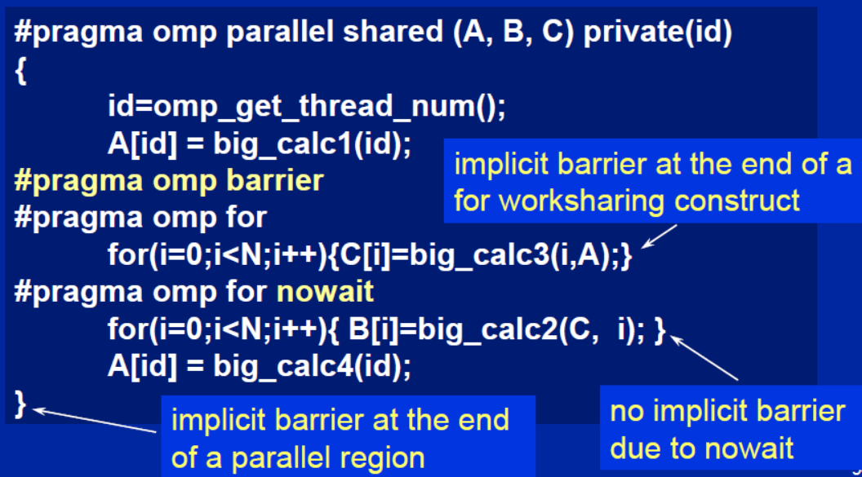
Synchronization: Barrier
Barrier: Each thread waits until all threads arrive.

Slide 5
Master Construct
master构造表示一个结构化块，它仅由主线程执行。
其他线程则跳过它（不需要同步）。
#pragma omp parallel
{
  do_many_things();
  #pragma omp master
  { exchange_boundaries(); }
  #pragma omp barrier
  do_many_other_things();
}
master默认没有barrier

Slide 6
Single Construct
single构造表示一个代码块，它仅由一个线程（不一定是主线程）执行。
在single块的末尾隐含了一个barrier（可以使用nowait子句移除）。
#pragma omp parallel
{
  do_many_things();
  #pragma omp single
  { exchange_boundaries(); }
  do_many_other_things();
}
与master区别：默认有barrier

Slide 7
Sections Construct
Sections工作共享构造，为每个线程提供一个不同的结构化块。
默认情况下，在“omp sections”的末尾有一个barrier。使用“nowait”子句可以关闭barrier 。
#pragma omp parallel
{
  #pragma omp sections
  {
  #pragma omp section
    x_calculation();
  #pragma omp section
    y_calculation();
  #pragma omp section
    z_calculation();
  }
}

Slide 8
Synchronization: Lock routines
A lock 意味着对所有线程可见变量的内存栅栏（一个“flush”）。
Simple Lock:
  A simple lock is available if it is unset.
  –omp_init_lock(), omp_set_lock(), omp_unset_lock(), omp_test_lock(), omp_destroy_lock()
Nested Locks:
比critical等更底层

Slide 9
Synchronization: Lock routines
A lock 意味着对所有线程可见变量的内存栅栏（一个“flush”）。
Simple Lock:
Nested Locks:
  如果嵌套锁unset，或者如果它已set但由执行嵌套锁函数的线程拥有，则可以使用嵌套锁。
  –omp_init_nest_lock(), omp_set_nest_lock(), omp_unset_nest_lock(), omp_test_nest_lock(), omp_destroy_nest_lock()

Slide 10
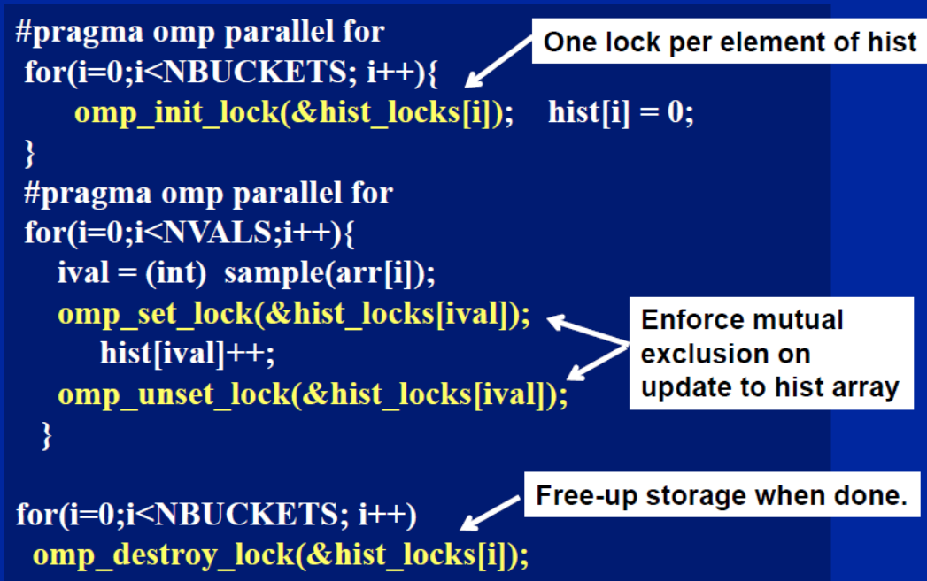
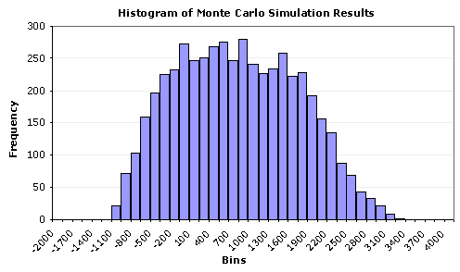
Synchronization: Simple Lock

Slide 11
Runtime Library routines
Runtime environment routines – 1 :
  修改/检查线程数：
  omp_set_num_threads(), omp_get_num_threads(), omp_get_thread_num(), omp_get_max_threads()
  查询当前代码是否处于并行区域?
    omp_in_parallel()

Slide 12
Runtime Library routines
Runtime environment routines – 2 :
  你希望系统在不同的并行构造（ parallel construct ）之间动态变化线程的数量吗？
    omp_set_dynamic(), omp_get_dynamic()
  How many processors in the system?
    omp_num_procs()

Slide 13
Runtime Library routines
Use fixed number of threads in a program:
#include <omp.h>
void main()
{ int num_threads;
  omp_set_dynamic( 0 );
  omp_set_num_threads( omp_num_procs() );
  #pragma omp parallel
  { int id=omp_get_thread_num();
  #pragma omp single
    num_threads = omp_get_num_threads();
    do_lots_of_stuff(id);
  }
}

Slide 14
Environment Variables
Set the default number of threads to use.
  –OMP_NUM_THREADS int_literal
Control the size of child threads’ stack
  –OMP_STACKSIZE
Hint to runtime how to treat idle threads
  –OMP_WAIT_POLICY
    – ACTIVE keep threads alive at barriers/locks
    – PASSIVE try to release processor at barriers/locks
Bind threads to processor
  –OMP_PROC_BIND
    – TRUE / FALSE turn on for better use of caches

Slide 15
Working with OpenMP
Synchronization 线程同步
Data environment 数据属性
Linked lists traversal 链表遍历

Slide 16
Data environment
默认存储属性:
  Shared Memory programming model:
    Most variables are shared by default (heap)
  Global variables are SHARED among threads:
    File scope variables, static
    dynamically allocated memory (ALLOCATE, malloc, new)
    But not everything is shared...
    Stack variables in functions called from parallel regions are PRIVATE
    Automatic variables within a statement block are PRIVATE.

Slide 17
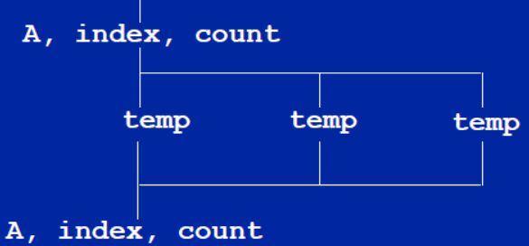
Data environment: example
double A[10];
int main() {
  int index[10];
  #pragma omp parallel
  work(index);
  printf(“%d\n”, index[0]);;
}
extern double A[10];
void work(int *index) {
  double temp[10];
  static int count;
  ...
}
A, index and count are shared by all threads.(heap)
temp is local to each thread.(stack)

Slide 18
Changing storage attributes
One can selectively change storage attributes for constructs using the following clauses:
    – SHARED
    – PRIVATE
    – FIRSTPRIVATE
The final value of a private inside a parallel loop can be transmitted to the shared variable outside the loop with:
    – LASTPRIVATE
The default attributes can be overridden with:
    – DEFAULT (SHARED | NONE)

Slide 19
Data Sharing: Private Clause
private(var)
  creates a new local copy of var for each thread.
  – The value of the private copies is uninitialized
  – The value of the original variable is unchanged after the region
void wrong() {
int tmp = 0;
#pragma omp parallel for private(tmp)
  for (int j = 0; j < 1000; ++j)
  tmp += j;
  printf(“%d\n”, tmp);
}

Slide 20
Data Sharing: Firstprivate Clause
firstprivate(var)
  Variables initialized from shared variable
  C++ objects are copy-constructed
incr = 0;
#pragma omp parallel for firstprivate(incr)
for (i = 0; i <= MAX; i++) {
  if ((i%2)==0) incr++;
  A[i] = incr;
}
Each thread gets its own copy
of incr with an initial value of 0

Slide 21
Data Sharing: Lastprivate Clause
lastprivate(var)
  Variables update shared variable using value from last iteration
  C++ objects are updated as if by assignment
void sq2(int n, double *lastterm) {
  double x; int i;
  #pragma omp parallel for lastprivate(x)
    for (i = 0; i < n; i++){
    x = a[i]*a[i] + b[i]*b[i];
    b[i] = sqrt(x);
    }
  *lastterm = x;
}
“x” has the value it held
for the “last sequential”
iteration (i.e., for i=(n-1))

Slide 22

Data Sharing: A Test
问题：
  Are A,B,C local to each thread or shared inside the parallel region?
  What are their initial values inside and values after the parallel region?

Slide 23
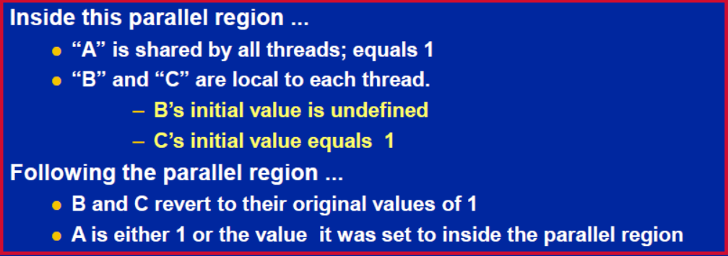
Data Sharing: A Test
Are A,B,C local to each thread or shared inside the parallel region?
What are their initial values inside and values after the parallel region?

Slide 24
Data Sharing: Default Clause
DEFAULT(SHARED)
  Note this is the default storage attribute
  Exception: #pragma omp task
DEFAULT(PRIVATE)
  To change default to PRIVATE
  each variable in the construct is made private as if specified in a private clause
DEFAULT(NONE):
  no default for variables in static extent. Must list storage attribute for each variable in static extent.
  Good programming practice!

Slide 25
Example: Serial PI Program
  static long num_steps = 100000;
  double step;
  int main ()
  {
  int i; double x, pi, sum = 0.0;
  step = 1.0/(double) num_steps;
  for (i=0;i< num_steps; i++){
  x = (i+0.5)*step;
  sum = sum + 4.0/(1.0+x*x);
  }
  pi = step * sum;
  }

Slide 26
Example: PI Program minimal changes
  #include <omp.h>
  static long num_steps = 100000; double step;
  int main ()
  {
  int i; double x, pi, sum = 0.0;
  step = 1.0/(double) num_steps;
  #pragma omp parallel for private(x) reduction(+:sum)
  for (i=0;i< num_steps; i++){
  x = (i+0.5)*step;
  sum = sum + 4.0/(1.0+x*x);
  }
  pi = step * sum;
  }

Slide 27
Working with OpenMP
Synchronization 线程同步
Data environment 数据属性
Linked lists traversal 链表遍历

Slide 28
Review
To create a team of threads
  􀂋 #pragma omp parallel
To share work between threads:
  􀂋 #pragma omp for
  􀂋 #pragma omp single
To prevent conflicts (prevent races)
  􀂋 #pragma omp critical
  􀂋 #pragma omp atomic
  􀂋 #pragma omp barrier
  􀂋 #pragma omp master

Slide 29
Review
Data environment clauses
  􀂋 private (variable_list)
  􀂋 firstprivate (variable_list)
  􀂋 lastprivate (variable_list)
  􀂋 reduction(+:variable_list)
variable_list 中的变量之间用逗号comma 分开.

Slide 30
Simple list traversal
基于已经介绍的OpenMP方法，如何并行处理这个循环？
the loop worksharing construct only works with loops for
The while loops are not covered
  p=head;
  while (p) {
    process(p);
    p = p->next;
  }

Slide 31
Test2：linked lists the hard way
Consider the program linked.c
  遍历一个链表，在每个节点计算一系列斐波那契数。
使用到目前为止所介绍的构造来并行化这个程序并优化它。
Code: test2_Fibonacci/linked.c

Slide 32
list traversal
OpenMP最初创建时，它专注于HPC中的常见用例：
  在“常规”循环上处理Fortran数组。
  递归和“指针追踪”从Fortran的关注点中被移除。
因此，即使简单的列表遍历（ list traversal ），对OpenMP的原始版本来说也极其困难。

Slide 33
Test2-1: Linked lists omp25
while (p != NULL) {
  p = p->next;
  count++;
}
p = head;
for(i=0; i<count; i++) {
  parr[i] = p;
  p = p->next;
}
#pragma omp parallel
{
  #pragma omp for schedule(static,1)
  for(i=0; i<count; i++)
  processwork(parr[i]);
}
Count number of items in the linked list
Copy pointer to each node into an array
Process nodes in parallel with a for loop
Code: test2_Fibonacci/solution/Linked_omp25.c

Slide 34
Linked lists
Using C++ STL
std::vector<node *> nodelist;
for (p = head; p != NULL; p = p->next)
nodelist.push_back(p);
int j = (int)nodelist.size();
#pragma omp parallel for schedule(static,1)
for (int i = 0; i < j; ++i)
processwork(nodelist[i]);
Count number of items in the linked list
Count number of items in the linked list
Process nodes in parallel with a for loop

Slide 35
Conclusion
如上，我们能够并行化链表遍历……
  但这很丑陋，并且需要多次遍历数据。
为了从科学计算（主要基于数组计算）拓展到更广泛的应用，我们需要：
  支持更一般的数据结构
  支持超出基本‘for’循环的循环
To do this, we have the OpenMP 3.0

Slide 36
references
Tim Mattson, A “Hands-on” Introduction to OpenMP, Intel Corp.
Mark Bull, Parallel Programming with OpenMP, EPCC, University of Edinburgh, UK.
迟学斌等，并行计算与实现技术，科学出版社。

